Slide 1





Q1 2026
Tested Marketing Optimization Tactics
SIGNAL
Your RAM is running low.
OPPORTUNITY
Free it to speed up your PC.
Susan Jeffery
Partner & Content Marketing Manager

Slide 2
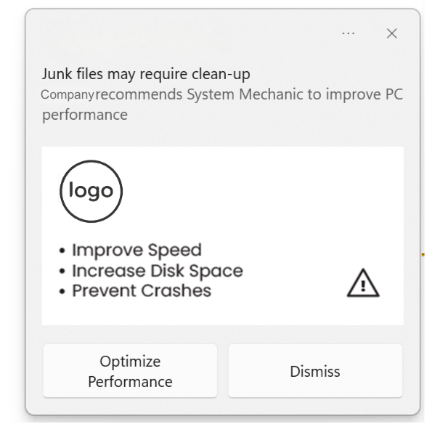
Recommended Preventative Toaster Design
Native design boosts performance and trust
Brand Recommends
Native Design
30-183% CTR lift across several partners
Benefits
Benefit CTA

Slide 3
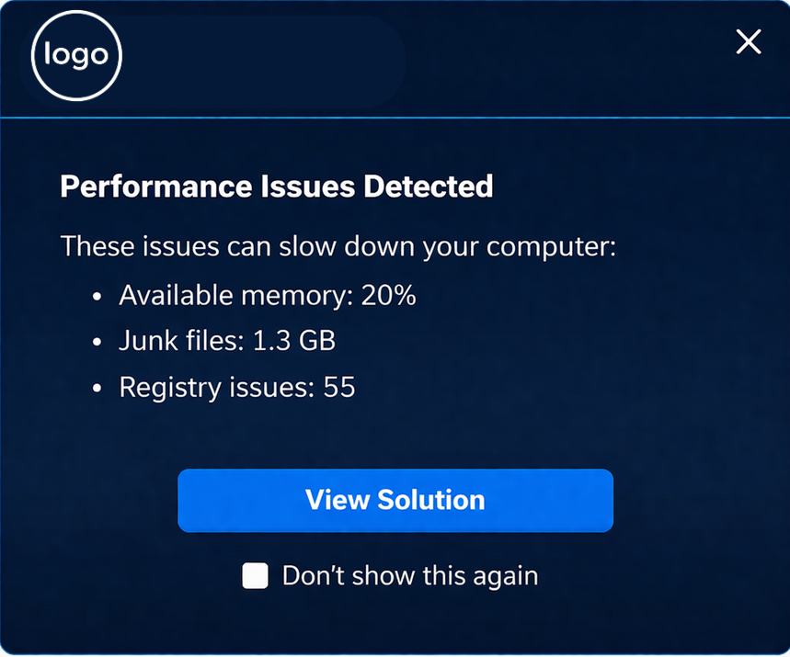
Recommended Native Design with Dynamic Messaging
Simplified design
28% CTR

Slide 4

Benefits in CTA boost results
2X CTR Improvement
Benefit vs Action:
Install < Upgrade

Slide 5
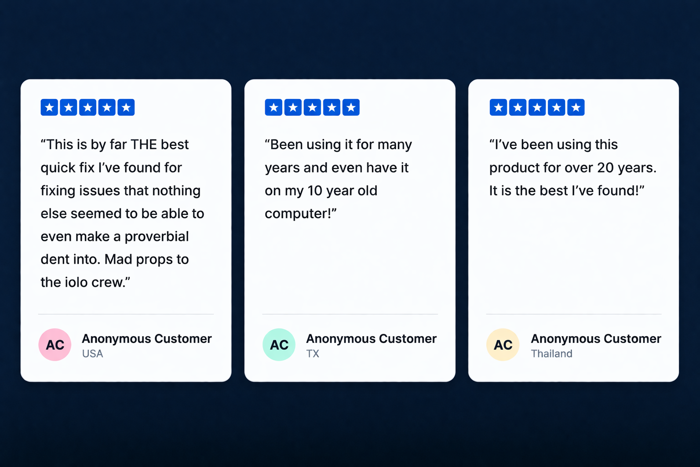
Does Social Proof Move the Needle? Not Here.
Adding social proof to a landing page
Had a 4.85% LOWER conversion rate

Slide 6
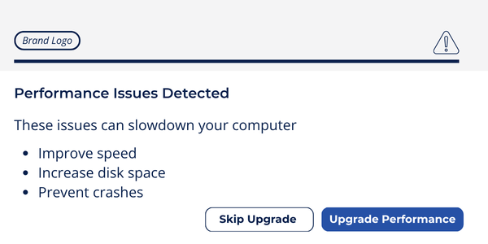
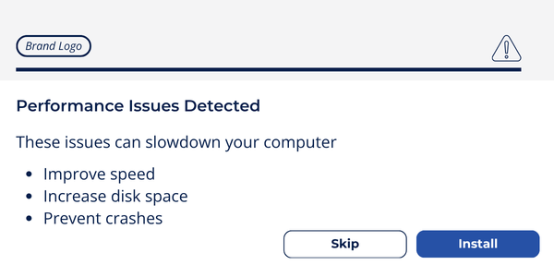
2X CTR

Slide 7
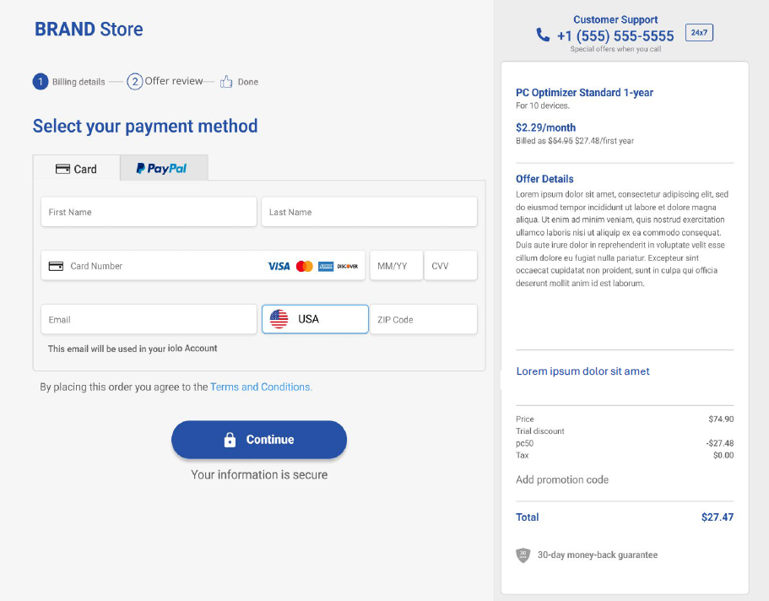
Who’s afraid of the word order?
Changing from “order” to “offer”
8.4%
Conversion Increase

