Slide 1
Tested conversion tactics
Susan Jeffery
October 2025 Partner update
Content & Partner Marketing Manager

Slide 2
Quick Takeaways
October 2025
Small changes to icons, layout, and design make an impact.
Test | Change | Results
Toaster: CTA button icon | Adding an arrow icon to the install CTA button | +18%
Email: design vs letter layout | Using a personal letter format vs graphic design | +7%
Order cart: remove logos | Simplify order cart by removing BBB and retail logos | + inconclusive
Landing page: CTA button language | Test action language in CTA buttons | +16%

Slide 3
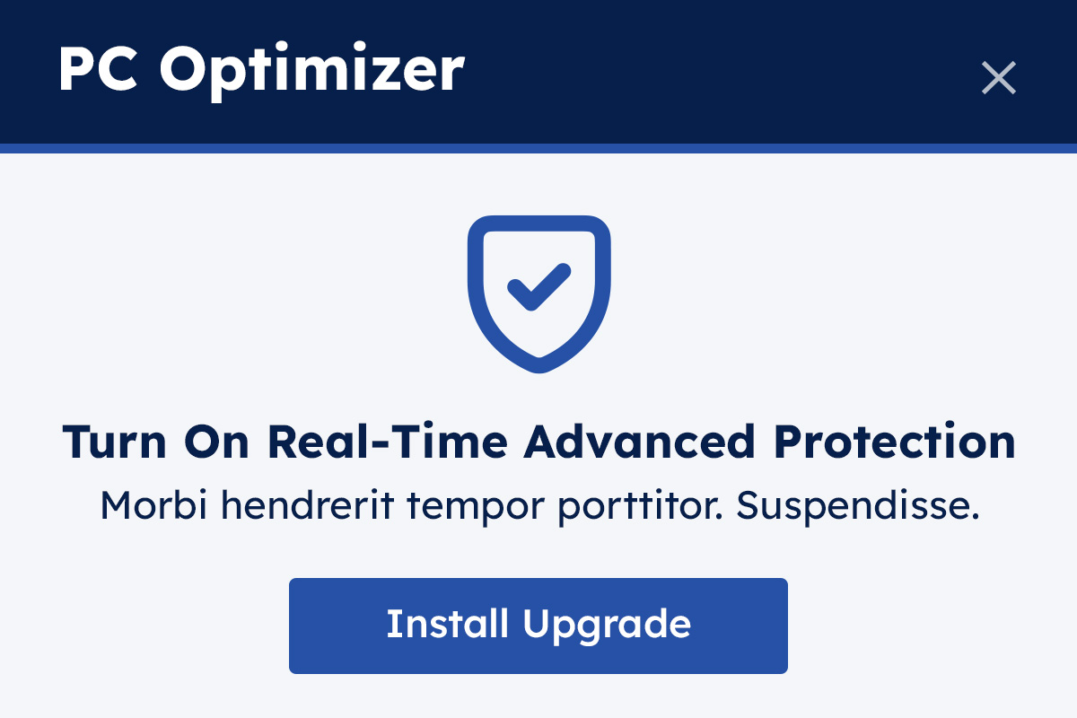
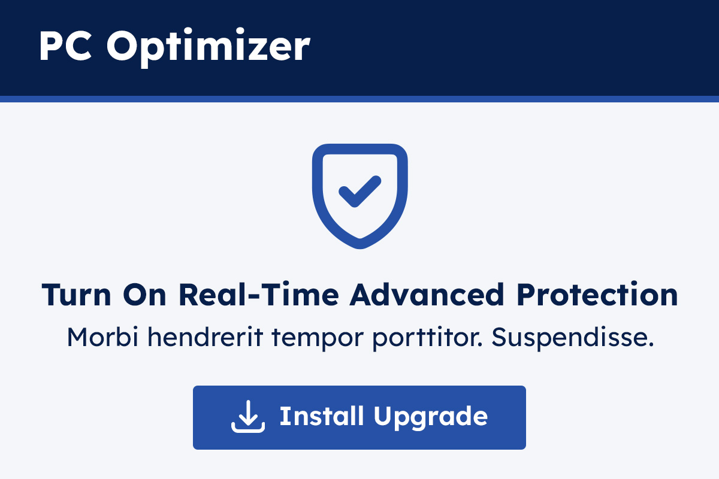
Toaster CTA button icon
October 2025
Adding an arrow icon to the “Install Upgrade” button increased conversions
WINNER 18% Improvement

Slide 4
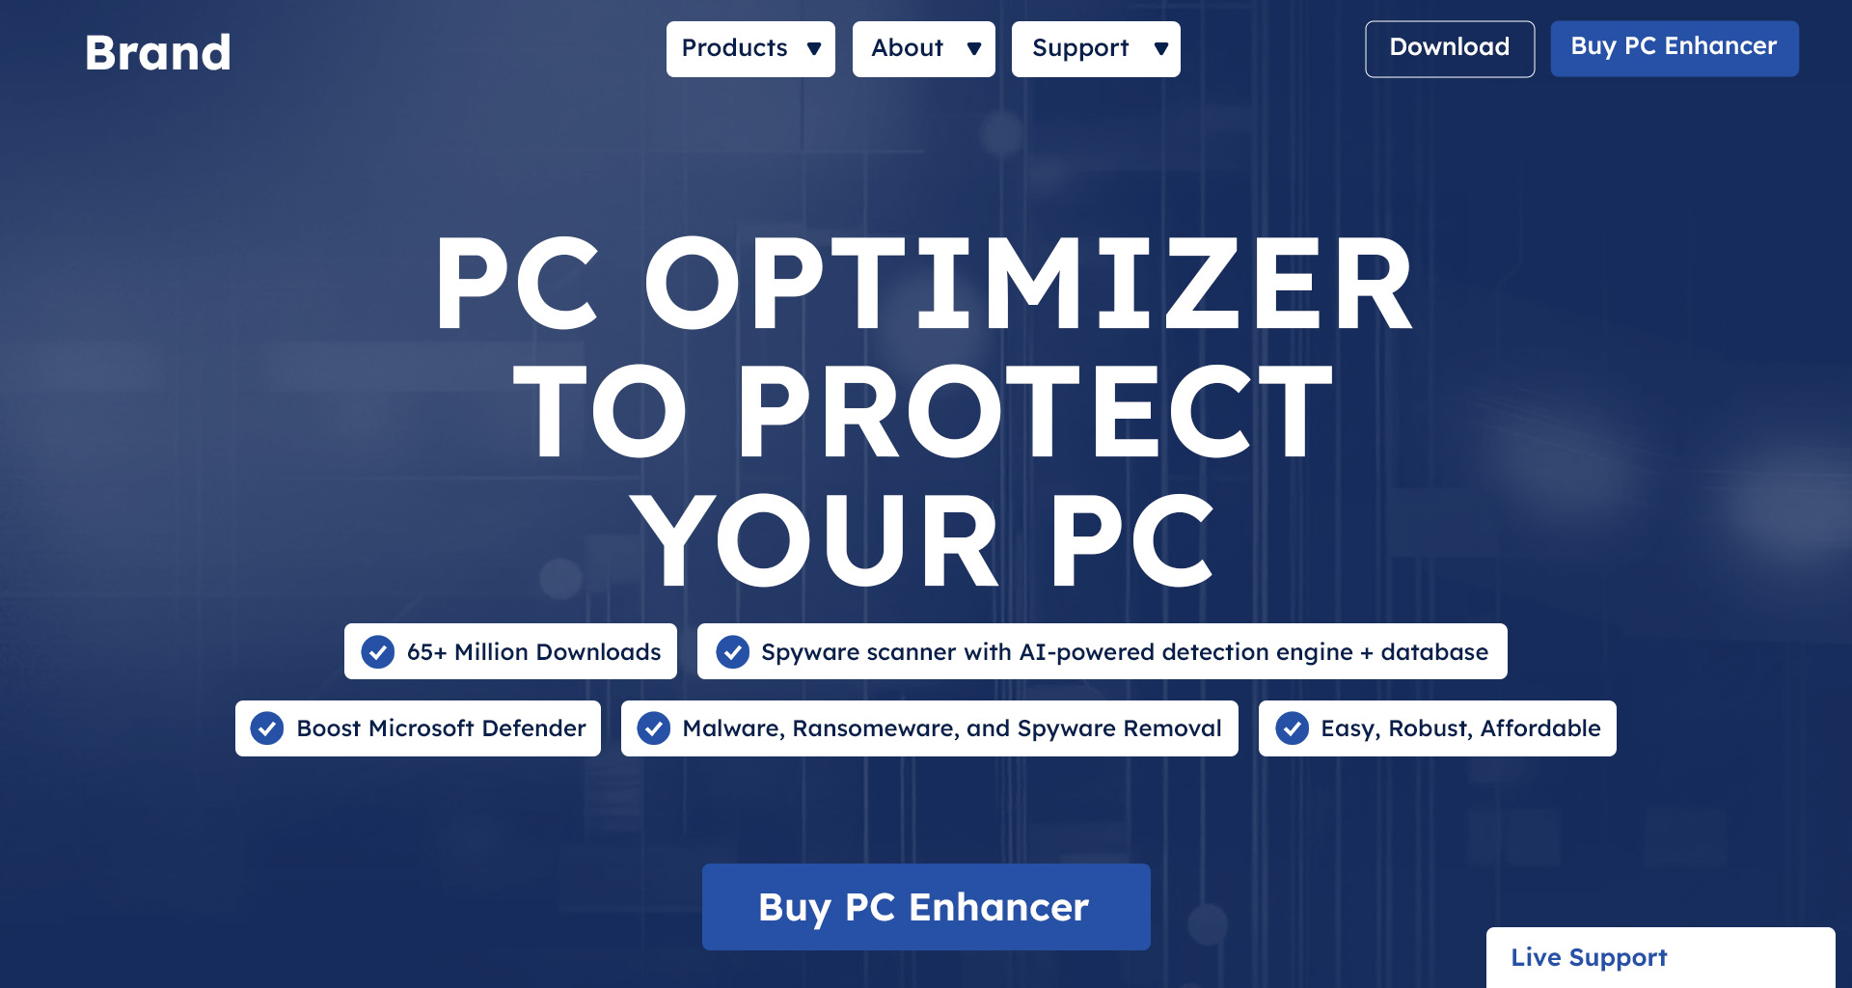


CTA language
October 2025
Change the language on the CTA button to be action-oriented.
Buy Pro X Edition (control)
Secure My PC Now
Protect My PC Now
Control
+16%
+8%

Slide 5
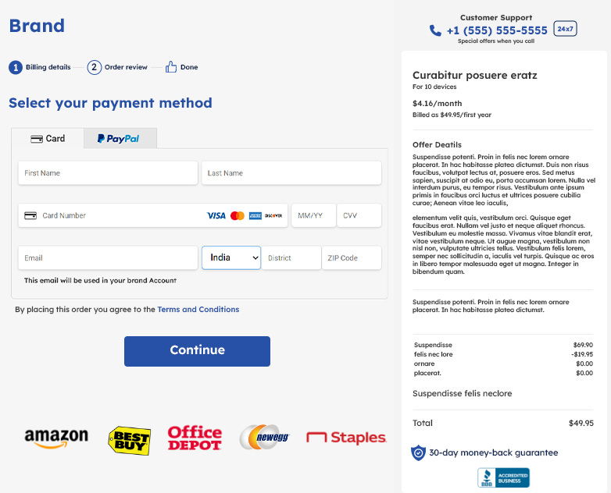
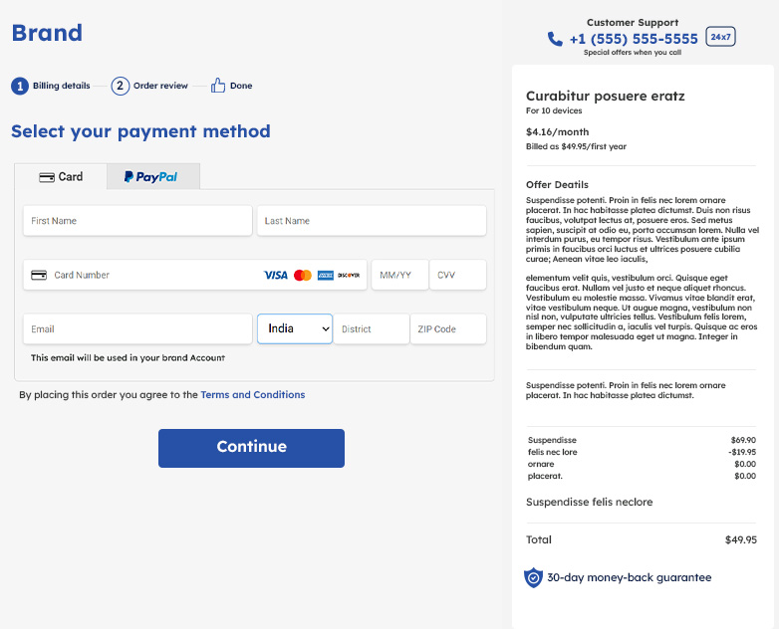
Order cart simplification
October 2025
Removing BBB and retail logos did not have conclusive results
Inconclusive

Slide 6
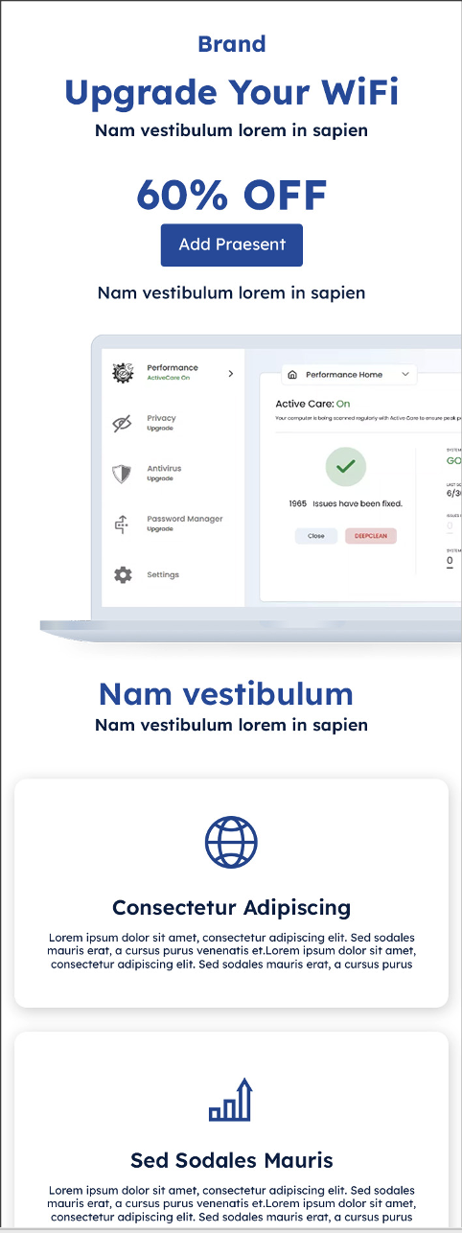
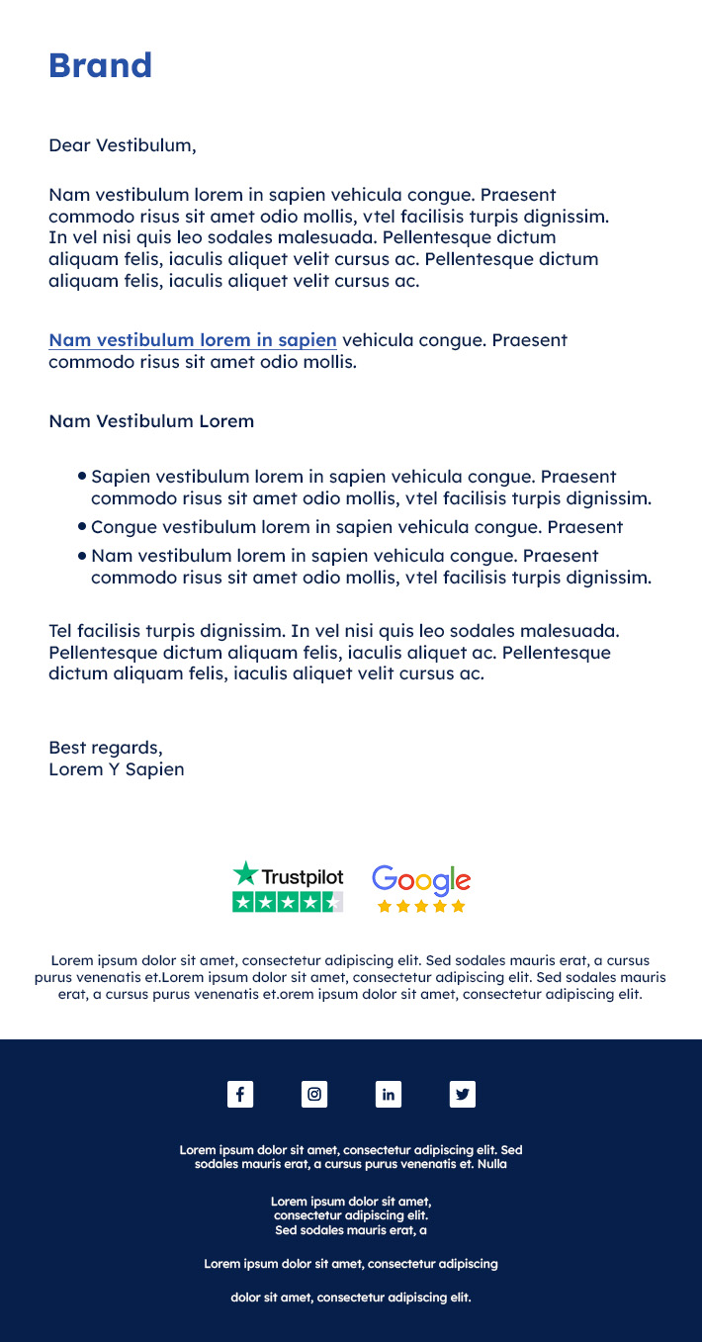
Email design vs letter layout
HTML Designed Layout
Letter Layout
October 2025
A personalized Letter Layout increased conversions vs. HTML Designed Layout
Winner
+7%

Slide 7



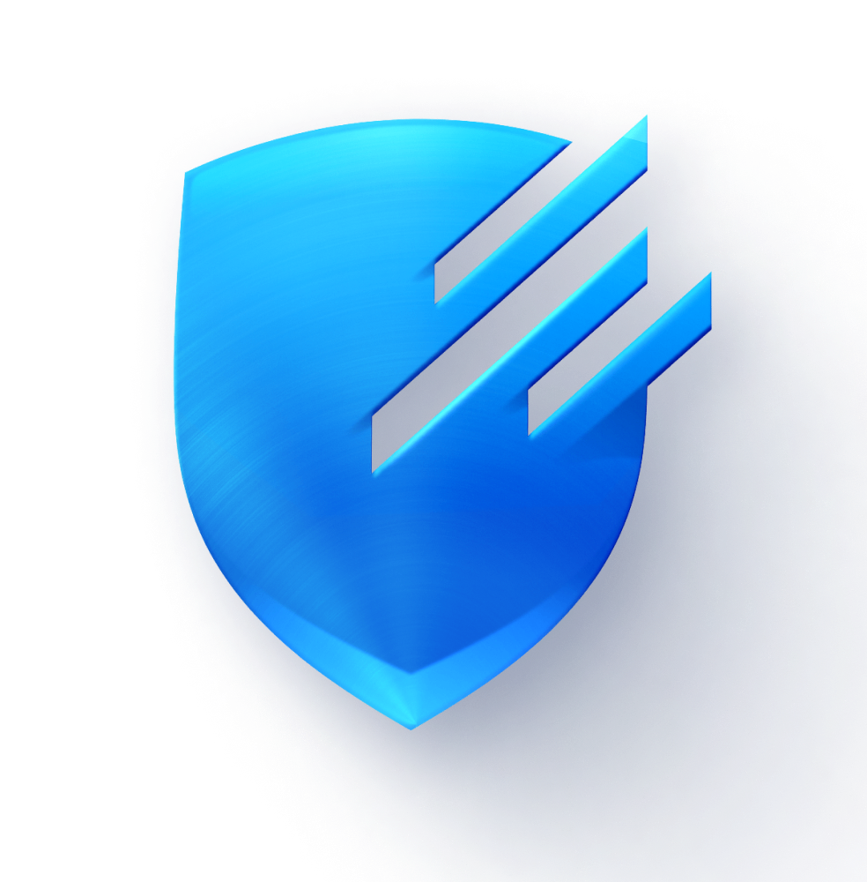

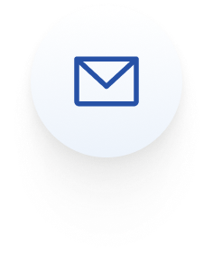
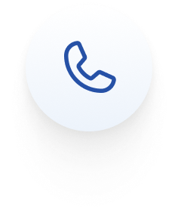
Let’s work together
Susan Jeffery
Content & partner marketing
Susan.jeffery@realdefen.se
+1 626-384-1620
Notes:
Use this one.

